Slide 1
Lecture 3
8086 Microprocessor.

Slide 2
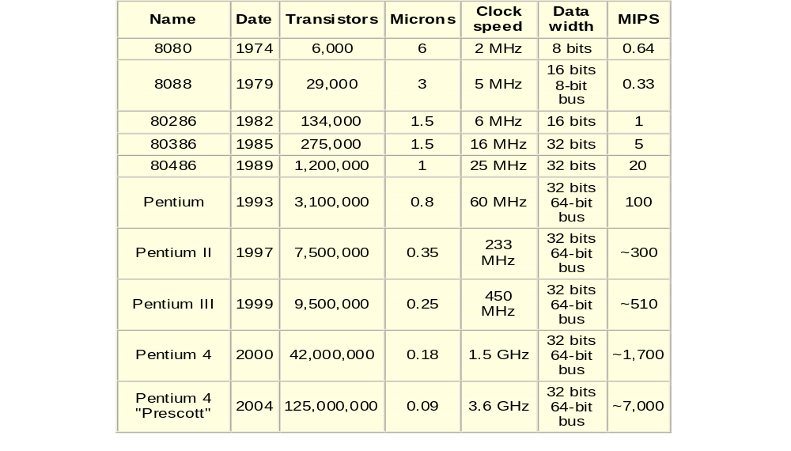

Slide 3
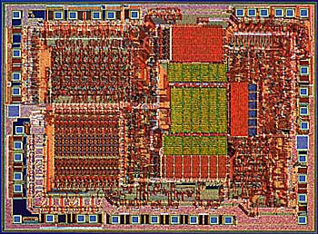
Overview: Intel 8086
Introduced in 1978
  Performance < 0.5 MIPS
16-bit architecture
  “Assembly language” compatible with 8080
  Designed using HMOS technology
  29,000 transistors
  Includes memory protection, support for Floating Point coprocessor
In 1981, IBM introduces PC
  Based on 8088--8-bit bus version of 8086

Slide 4
8086 Features
Manufacturing process 3 micron N-channel, silicon gate technology (HMOS)
29,000 transistors
Data bus width: 16 bit
Address bus width: 20 bit
Physical memory: 1MB
Package 40-pin side-brazed ceramic DIP
Speed: 5 MHz
Floating Point Unit: 8087
V core (V): 5 ± 10%
Min/Max operating temperature (°C): 0 – 70
16-bit Arithmetic Logic Unit
16-bit data bus (8088 has 8-bit data bus)

Slide 5
8086 Features
• 20-bit address bus - 2²⁰ = 1,048,576 = 1 meg
The address refers to a byte in memory.
In the 8088, these bytes come in on the 8-bit data bus.
In the 8086, bytes at even addresses come in on the low half of the data bus (bits 0-7) and bytes at odd addresses come in on the upper half of the data bus (bits 8-15).
The 8086 can read a 16-bit word at an even address in one operation and at an odd address in two operations. The 8088 needs two operations in either case.
The least significant byte of a word on an 8086 family microprocessor is at the lower address.

Slide 6
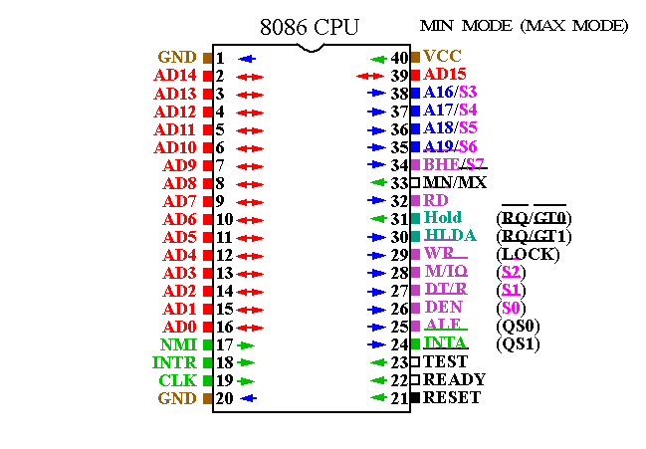

Slide 7
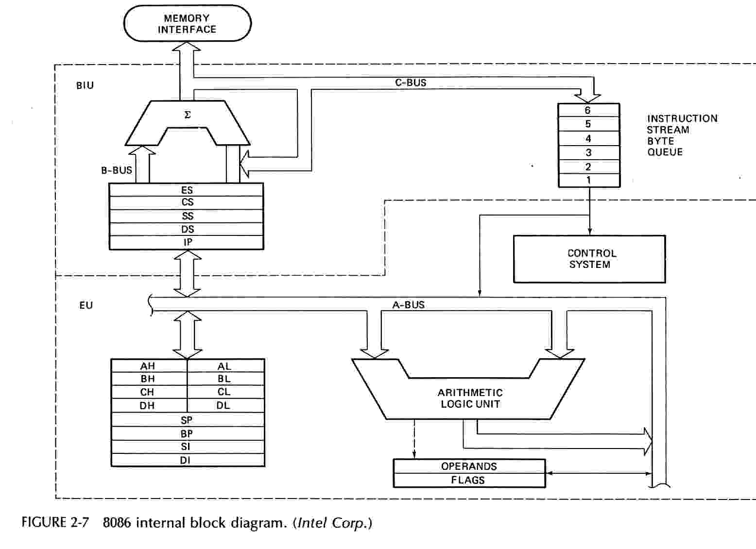
8086 Architecture

Slide 8
8086 Architecture
• The 8086 has two parts, the Bus Interface Unit (BIU) and the Execution Unit (EU).
• The BIU fetches instructions, reads and writes data, and computes the 20-bit address.
• The EU decodes and executes the instructions using the 16-bit ALU.

Slide 9
Bus Interface Unit (BIU)
The BIU contains the following registers:
    IP - the Instruction Pointer
    CS - the Code Segment Register
    DS - the Data Segment Register
    SS - the Stack Segment Register
    ES - the Extra Segment Register
The BIU fetches instructions using the CS and IP, written CS:IP, to construct the 20-bit address.
Data is fetched using a segment register (usually the DS) and an effective address (EA) computed by the EU depending on the addressing mode.

Slide 10
Instruction Queue
  The BIU’s instruction queue is a First-In-First-Out (FIFO) group of registers, in which up to six bytes of instruction can be pre-fetched from memory ahead of execution.
  This mechanism is called pipelining.
  If the queue is not full and empty by two bytes, the BIU may pre-fetch instructions.
  The queue allows the BIU to keep the EU supplied with pre-fetched instructions without tying up the system bus.

Slide 11
Execution Unit
The EU contains the following 16-bit registers:
AX - the Accumulator
BX - the Base Register
CX - the Count Register
DX - the Data Register
SP - the Stack Pointer \ defaults to stack segment
BP - the Base Pointer /
SI - the Source Index Register
DI - the Destination Register
These are referred to as general-purpose registers, although, as seen by their names, they often have a special-purpose use for some instructions.

Slide 12
General purpose Registers of 8086
The AX, BX, CX, and DX registers can be considered as two 8-bit registers, a High byte and a Low byte.
This allows byte operations and compatibility with the previous generation of 8-bit processors, the 8080 and 8085.
8085 source code could be translated in 8086 code and assembled.
The 8-bit registers are:
        AX --> AH,AL
        BX --> BH,BL
        CX --> CH,CL
        DX --> DH,DL

Slide 13
8086 Programmer’s Model
ES
Extra Segment
_{BIU registers}
_{(20 bit adder)}
CS
Code Segment
SS
Stack Segment
DS
Data Segment
IP
Instruction Pointer
_{EU registers}
AX
AH
AL
Accumulator
BX
BH
BL
Base Register
CX
CH
CL
Count Register
DX
DH
DL
Data Register
SP
Stack Pointer
BP
Base Pointer
SI
Source Index Register
DI
Destination Index Register
FLAGS

Slide 14
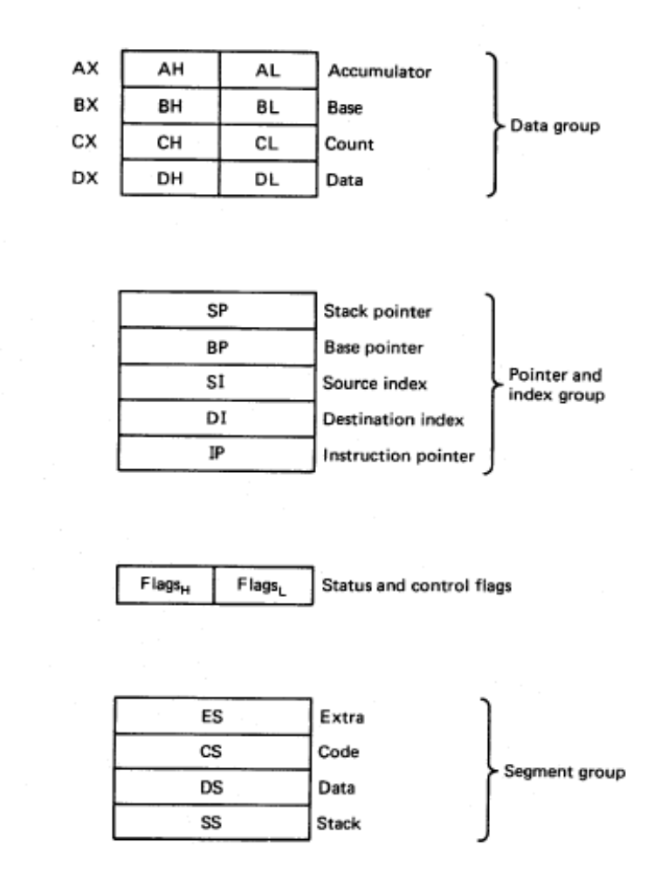
8086/88 internal registers 16 bits (2 bytes each)
AX, BX, CX and DX are two
bytes wide and each byte can
be accessed separately
These registers are used as
memory pointers.
Flags will be discussed later
Segment registers are used
as base address for a segment
in the 1 M byte of memory

